Slide 1

Intro To Machine Learning Workshop 1
IEEE AUS Student Branch in collaboration with Google Developer Student Club
By Rohan Mitra

Slide 2
What is Machine Learning?
Ability for machines to perform tasks at an ability similar to humans
Machines doing a lot of math to do things like humans

Slide 3
Two Main Types of Machine Learning
Classification
Identifying which “class” the input belongs to
Identifying a dog vs a cat, Predicting if it will rain tomorrow or not
Could be distinguishing between 2 classes (binary classifier) or multiple classes (Multi-class classifier)
Regression
Predicting a continuous numerical value
How much will it rain tomorrow (in mm)? How much would a stock be tomorrow?

Slide 4
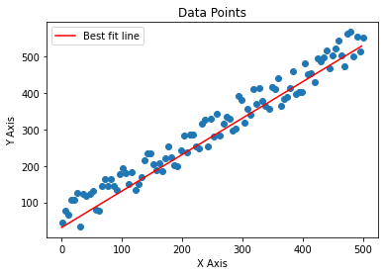
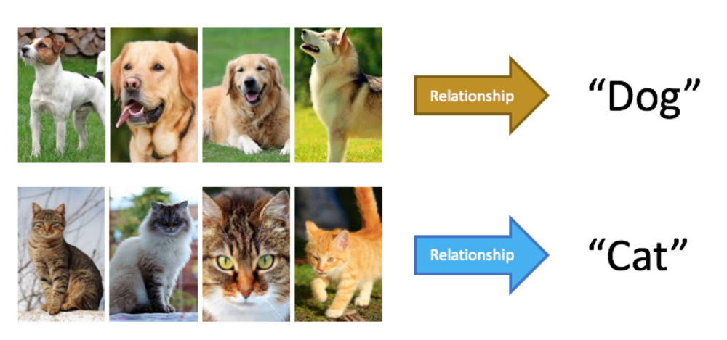
Two Main Types of Machine Learning
Classification
Identify a pattern in the data that helps distinguish the classes
Eg:
Regression
Fit a “line of best fit” that would most accurately go through a set of data points
Eg:

Slide 5
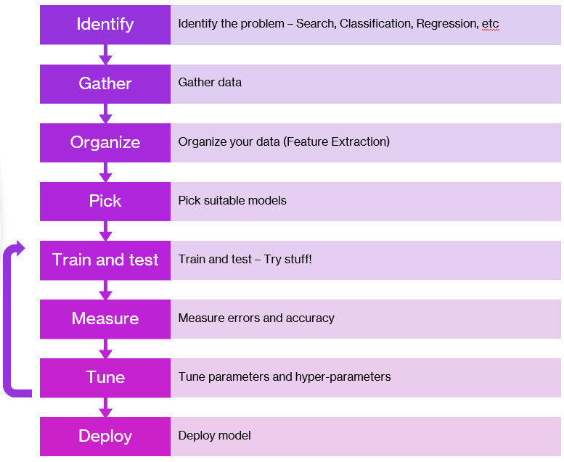
The Process

Slide 6
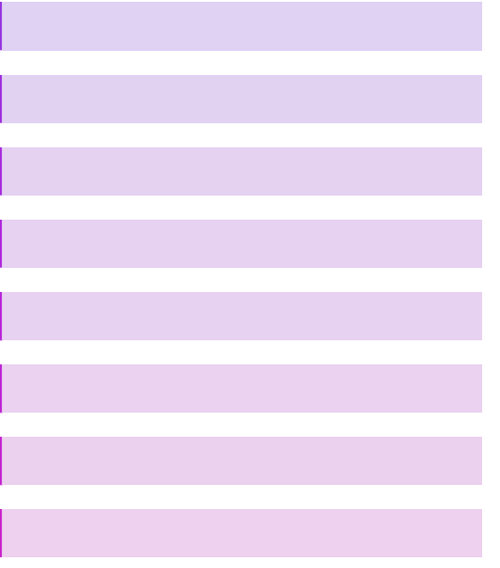

Analogy: Teaching A Student
Which Course are you teaching?
Make the syllabus
Prep & arrange the Q&A
Pick student
Let student learn $→$ Give exam
Grade the exams
Change the way students learn
Student Graduates

Slide 7
Preprocessing
Arranging your data properly
Examine quality of data (Plot graphs, observe trends)
For image data:
Apply filters?
Edge detection?
Resizing/rotating/transforming?
For tabular data:
Ensure the range isn’t too large (relatively)
Dealing with missing (NULL) values – (remove entire row or fill a value?)
Are they numeric or categorical?
One Hot Encoding?

Slide 8
Managing the data (Syllabus vs Exam)
Syllabus/textbooks don’t contain the same questions as the exam
3 groups of data needed:
Training – Most of your data (60%-80%) to learn from
Testing – Small part of your data (10%-30%) for the exam
Validation – Small part of data (10%-20%) for midterms after every chapter
Take the entire dataset and split it into Training & Testing (May use validation set too)
Train
Test
Validation

Slide 9
Measuring Success
Classification:
Precision
Recall
F1 Score
Accuracy
Regression:
MSE
RMSE
Accuracy

Slide 10
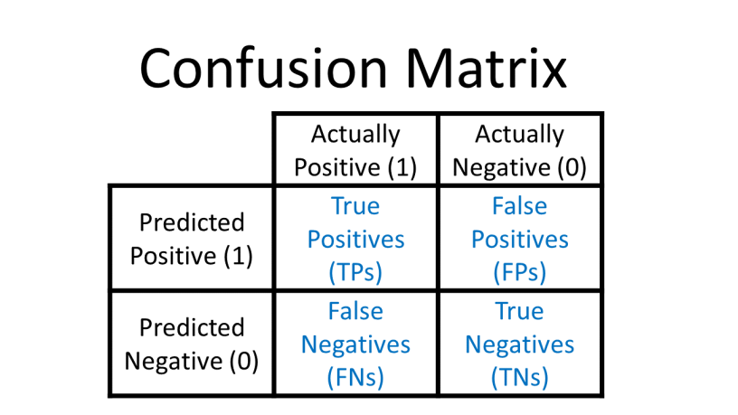
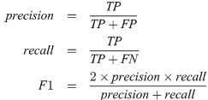
Measuring Success Classification

Slide 11
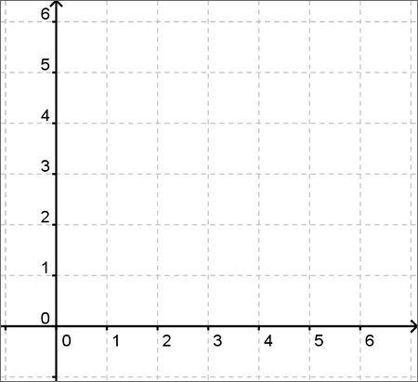
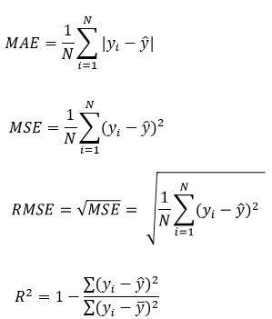
Measuring Success Regression

Slide 12
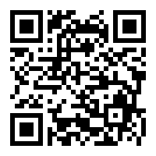

Thank you!
Find all code used in all workshops at: https://github.com/ro1406/MLWorkshop-IEEEAUS
Contact me on Instagram for any questions: @rohan14_official
While you're there, follow @ieee_aus and @gdscaus for updates!

